Slide 1
Use of Seiscomp3 in Mexico
Jesús Antonio Pérez Santana
Instituto de Geofisica, UNAM
Servicio Seismológico Nacional
jesus@sismologico.unam.mx
Seiscomp3 User Group Meeting
Potsdam, Germany
January 17, 2013

Slide 2
Integration of SC3 into the SSN
- Seiscomp3 was installed at the end of the year 2010 in Mexico.
- The solutions generated by Seiscomp3 during important earthquakes at 2011 were very good, and we began to consider to use its results as preliminary information.
- The challenge was how to integrate the solutions generated by Seiscomp automatically into the SSN information systems:
Web
SMS
e-mail
Twitter.

Slide 3
Integration of SC3 into the SSN
- We analized the Seiscomp3 behaviour, and identified that each time SC3 generates a new solution, it creates or updates a summary file that follows a specific filesystem structure under de EVENTS directory:
/home/sysop/.seiscomp3/log/events/2013/01/01/dir-event-id/summary-file
Each summary file contains the epicenter coordinates, number of phases, and magnitude of the event, as well as information regarding the time SC3 generated each solution.

Slide 4
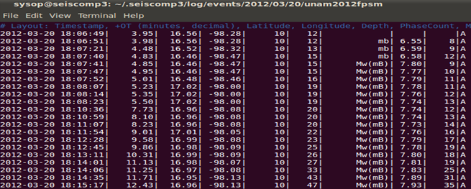
Integration of SC3 into the SSN
SEISCOMP SUMMARY FILE EXAMPLE

Slide 5
Integration of SC3 into the SSN
SEISCOMP3
Summary
Filename
PERL SCRIPT
Checks Each Summary Event File
Coordinates
Phases
Magnitude
IWATCH
Looks for
New SC3 Summary Files
Summary FILE
SSN Info
Distribution
Process
Twitter
e-mail
Web
SMS

Slide 6
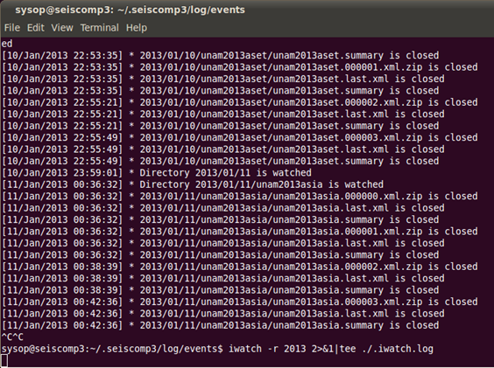
Integration of SC3 into the SSN
iwatch –r 2013 > iwatch.log

Slide 7
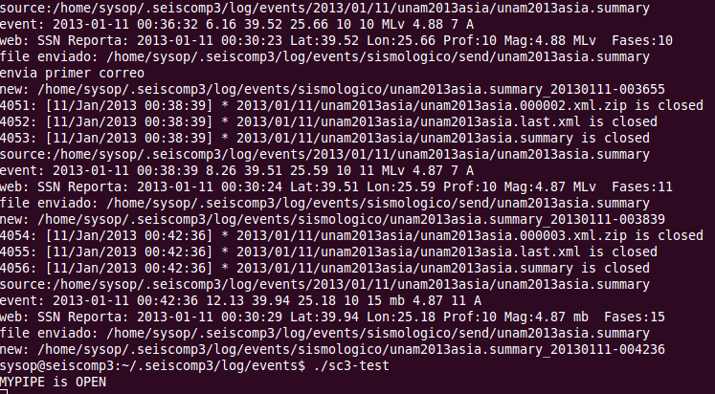
Integration of SC3 into the SSN
iwatch.log is READ by the PERL SCRIPT

Slide 8
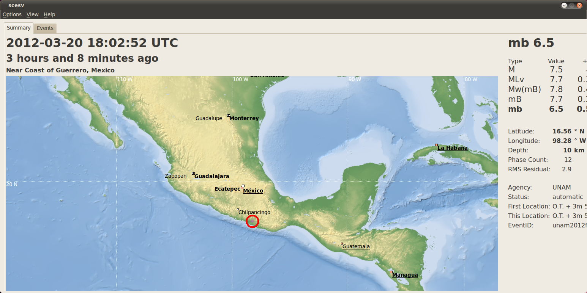
Integration of SC3 into the SSN
SC3 Solution

Slide 9
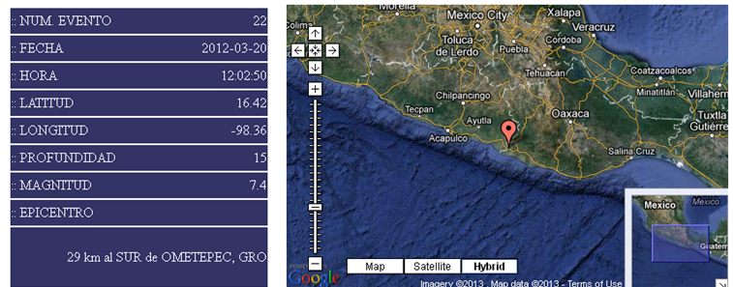
Integration of SC3 into the SSN
> 20 min OT Final Solution 16.42N 98.36 W 15 Km Mw 7.4
3.95 min OT Ph12 SC3 Solution 16.56N 98.28 W 10 Km Mb 6.5
4.85 min OT Ph15 SC3 Solution 16.46N 98.47W 10 Km Mw7.8

Slide 10
Integration of SC3 into the SSN
Conclusions
SC3 is a reliable program to determine automatically the
Epicenter and Magnitude of an Event
It’s very important to define the minimum number of phases that must be used to made the information available to the public
For big Earthquakes (M>5) you must wait for the SC3 Mw Solution
SC3 is a strategic element for the SSN operation in Mexico.
Thanks !

